Slide 1
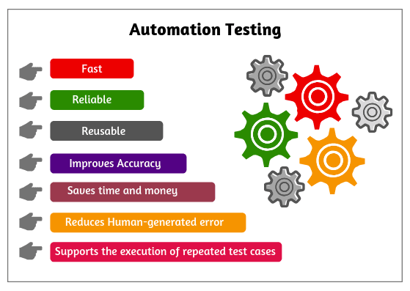



Comparison between manual and automated testing
Members:
37 Mikil Lalwani
56 Nilay Pophalkar
58 Sanskruti Punyarthi
61 Shree Samal

Slide 2

About the paper
paper context
Authors
journal
Date
ISSN
Bhawna Kumari, Naresh Chauhan, Vedpal
JETIR (Journal of Emerging Technologies and Innovative Research)
December 2018
2349-5162

Slide 3

Table of Contents!
1.Introduction
3. Automated testing
2. Manual testing
4.Result and summarization
Purpose,approaches and need of testing
Benefits,
process,tool
Goals,disadvantages,
Test case(structure and execution)
Result,conclusion,

Slide 4

Introduction
Purpose:
Defect Detection,Quality Assurance,Risk Mitigation
Approaches:
Manual Testing (Human Execution,)Automated Testing (Scripted Testing)
Need :
Improve User Experience ,Save cost

Slide 5
Manual testing
Definition
Advantages
Disadvantages
Detect Defects
Time consuming
Most basic and rigorous type of software testing.
Software testers writes the test cases
No use of any special software.
Identify,report defects by executing test cases
Meticulous design,execute and document tests.
Test Coverage
Human errors
Test various aspects of the software
Unintentionally overlook,misinterpretation,monotonous process.
Retesting
Less scalability
Provide manual testing on fixed defects.
Challenging to scale for large,complex projects.

Slide 6

Test case - structure
A test which checks the functionality
of specific module
Expected result
Test case id
Behavior of the software under specific condition
Unique identification no.
Test case description
Actual result
Actual outcomes observed
Explanation and narrative of test case
Test case steps
Status
Detailed set of instructions
Passed/Failed/
Blocked/cancel
Test case data
Test case -by/date
Input values, parameters, or data sets
Name of the tester , date of test execution

Slide 7
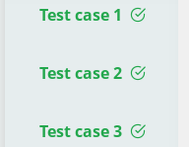
Test case - Execution
Total no. of test cases executed.
No. of defects found in the testing process.
Record of success and failure execution of test cases in document.
Record of time taken to execute the testsuite

Slide 8


Automated testing
The tester writes scripts with use of suitable software to test the application.
Automated Testing is a simplified process of manual testing.
Wider test coverage
Benefits
70% faster than execution of manual test cases
Saves time and cost.
Extends reliability.
Provides more accurate results.

Slide 9

Automated testing process
1
The selection of automation tool
4
Design framework and its features.
2
Determination of scope of automation
5
Automation scripts execution
3
creation of automation strategy
6
Automation
scripts are added ,reviewed and maintained

Slide 10
Selenium
(Automation Tool]
Selenium RC
The first automated web testing tool that allowed the users to use multiple programming languages like java , c# , PHP , Python , Perl , Ruby
Open source web-based automation tool,designed to automate web browser interactions
WebDriver
Selenium IDE
Interaction with browser take place in a more realistic manner with the help of webdriver
The simplest framework in the selenium suite.It is a prototype tool. This firefox extension helps in automation of the browser through a record-and-playback feature.
Selenium grid
Multiple tests can be run at the same time with the help of
this tool.

Slide 11
Selenium Testing Process
Create a webdriver instance.
Navigate to a webpage.
find an HTML element on the web page.
Perform an action on an HTML element.
Predict the browser response to the action.
Run and record test results using a test framework.

Slide 12

Results
M- Manual Testing
A- Automated Testing
Comparisons
Parameters | M | A
Time consuming
Human observation
Tools Availability
Programming Knowledge
Comoarisons
Parameters | M | A
Automated test scripts
Easy parallel Execution
More accuracy
Reliability

Slide 13
Conclusion
It is concluded
that automated testing has its own importance , benefits over manual testing
Referred paper has performed experimental work on web applications.
Manual testing and automation testing was
implemented on web applications using software testing tool like selenium

Slide 14



Thankyou

